Slide 1
Positive Externalities
Jacob N
Luke G
Owen S

Slide 2
The Vocabulary
Marginal Social Benefits- the change in social benefits associated with the consumption of an additional unit of a good or service.
3rd Party- the person, firm, group or society who benefits from positive externalities independent from those involved in the transaction.
Market Failures- in terms of positive externalities, a market failure is a case when the marginal social benefits of a good should point to much more production than the equilibrium production of said product in a market
Pigouvian Subsidies- are provided to an activity on the grounds that the activity generates positive externalities

Slide 3
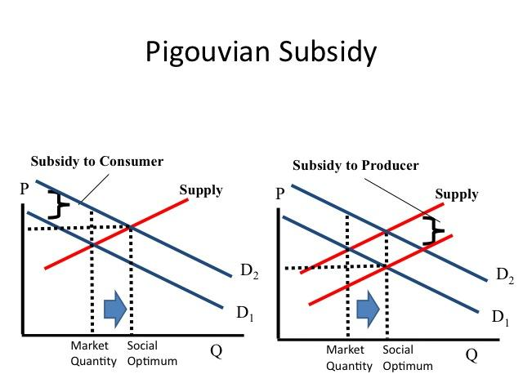
Graphs
-used to correct positive externalities
-Subsidy to consumer increases demand for a good
-Subsidy to producer decreases the marginal cost to make a good
-when a positive externality exists, the market is producing less than the socially optimal quantity

Slide 4
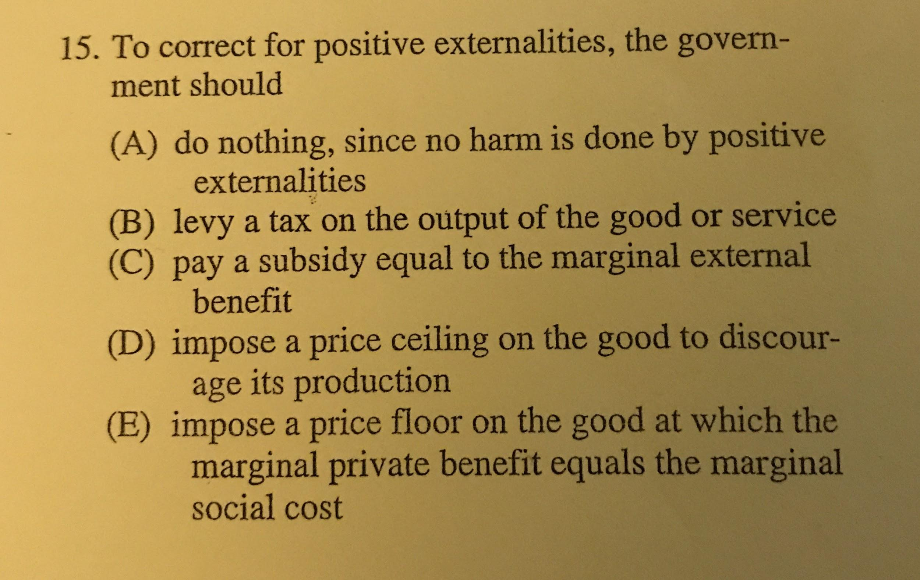

Slide 5
C
The government should pay a subsidy equal to the good’s marginal social benefit because the government wants to encourage the production and consumption of this product which has positive externalities.

Slide 6
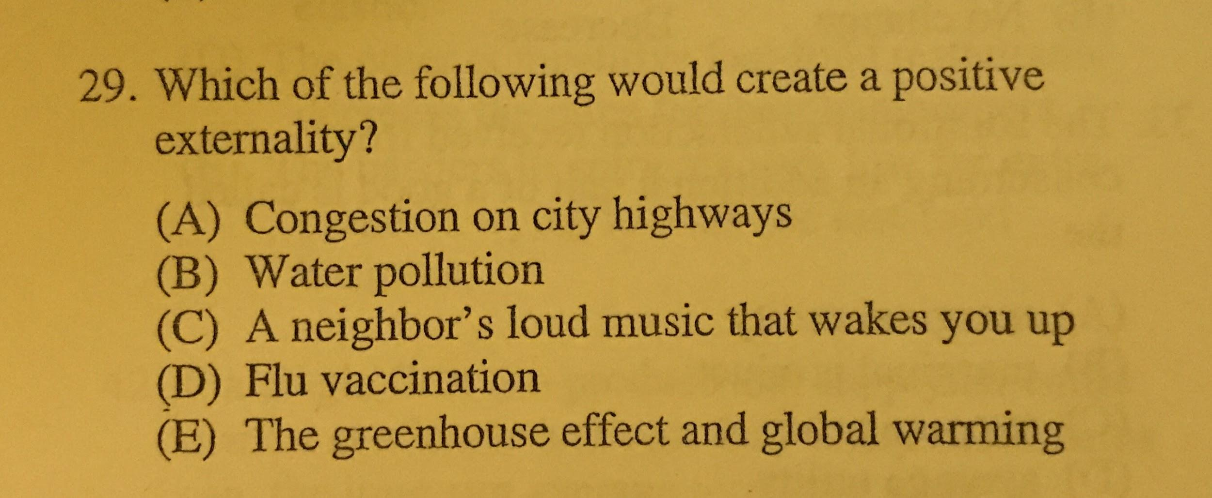

Slide 7
D
The flu vaccination would create a positive externality because it would not only prevent the individual from contracting the flu but also would help to prevent the flu from spreading as fewer people are able to contract it and spread it.

Slide 8
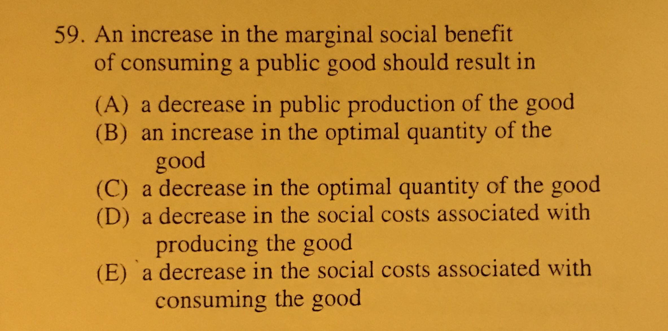

Slide 9
B
The answer is that, if a product offers a large marginal social benefit (otherwise known as a positive externality), ideally more of that product is being produced (increase quantity).

Slide 10
Real World Applications
Some examples of positive externalities are things like flu shots and solar panels. Each of these products offers a marginal social benefit. Thus, these products are often subsidized by the government (pigouvian subsidies). An example of a market failure would be an incident when flu shots were too expensive for a doctor's office so they stopped offering them.

